Slide 1
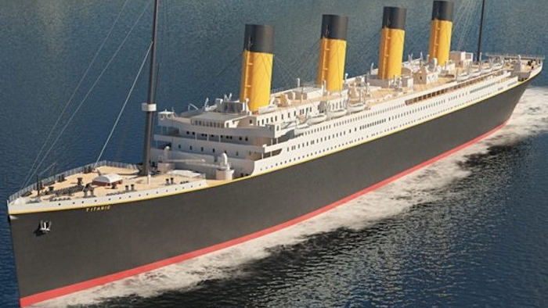
GROUP 6 : PASSENGER SURVIVAL PREDICTION ON TITANIC DATASET
Dhilipan Dushendran (dd3255@drexel.edu)
Tej Gottapu (tg672@drexel.edu)

Slide 2
Background and Objective:
RMS Titanic was a British passenger liner operated by the White Star Line that sank in the North Atlantic Ocean in the early morning hours of 15 April 1912, after striking an iceberg during her maiden voyage from Southampton to New York City. Of the estimated 2,224 passengers and crew aboard, more than 1,500 died, making the sinking one of modern history's deadliest peacetime commercial marine disasters.
The objective of the project is to use machine learning to create a model that predicts which passengers survived the Titanic shipwreck.The model is trained on the trainign data and would be used on the testing data to predict the outcome.

Slide 3
Data Exploration
The dataset was obtained from Kaggle.(https://www.kaggle.com/c/titanic/overview.)
The data from the Kaggle dataset was given in form of 'Train' and 'test' data .The train data is used to analyze the data and to train the model and it would be implemented on the testing dataset to find out the passenger survival rate.Train.csv will contain the details of a subset of the passengers on board (891 to be exact) and importantly, will reveal whether they survived or not, also known as the “ground truth”.
The dataset has 12 columns
'PassengerId’ ,'Survived’ ,'Pclass’, 'Name’ ,'Sex’, 'Age’, 'SibSp’, 'Parch’, 'Ticket’ ,'Fare’ ,'Cabin' 'Embarked

Slide 4
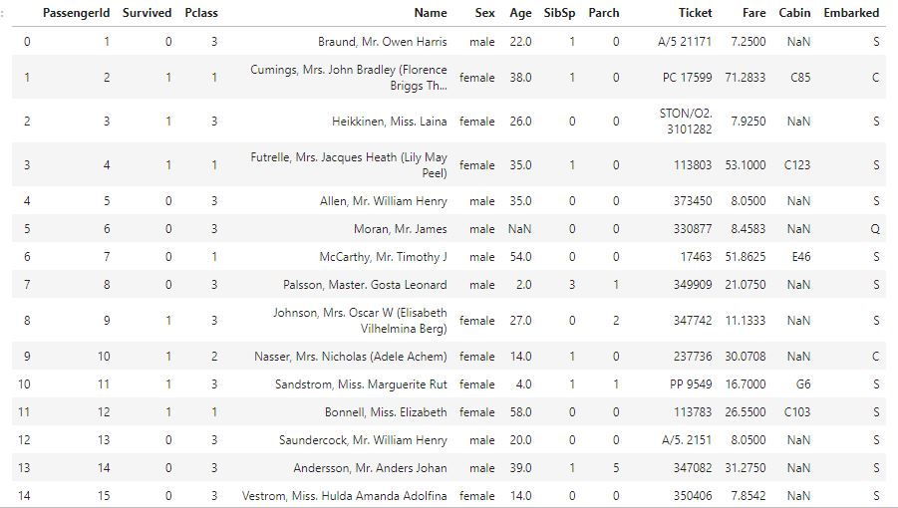
Columns in the Dataset

Slide 5
Description of columns:
PassengerId : It indicates the Passenger id
Survived : "It is '0' or '1'. It indicates whether the passenger has survived or not.(1survived,0 for not survived)
Pclass : There are three classes 1,2,3 (can be considered as Economy,Business and First)
Name : Passenger Name
Sex : Passenger gender
Age : Passenger age
SibSp : "Sibling and Spouse (Sibling = *brother, sister, stepbrother, stepsister, Spouse =* husband, wife )
parch: Number of Parents/Children Aboard
ticket : Ticket Number
fare : Passenger Fare
cabin : Cabin
embarked : Port of Embarkation (C = Cherbourg; Q = Queenstown; S = Southampton)

Slide 6
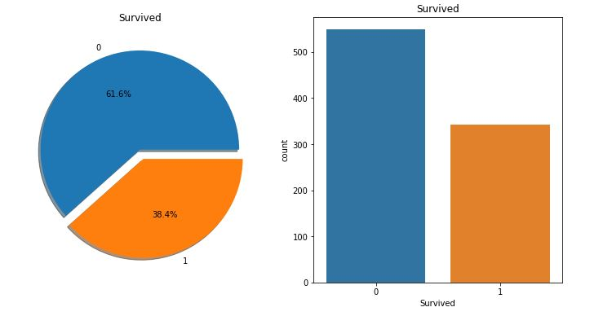
Data Visualization:

Slide 7
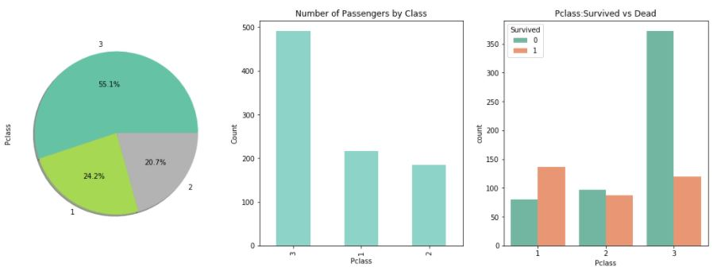
Passenger Class vs Survival:

Slide 8
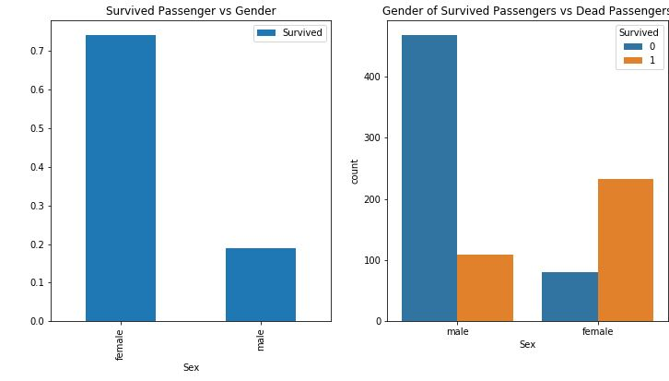
Gender vs Survival:

Slide 9
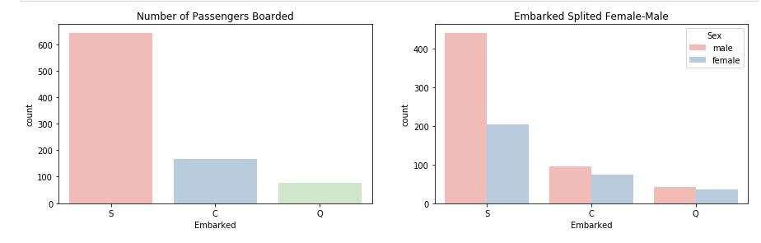
Passengers embarked

Slide 10
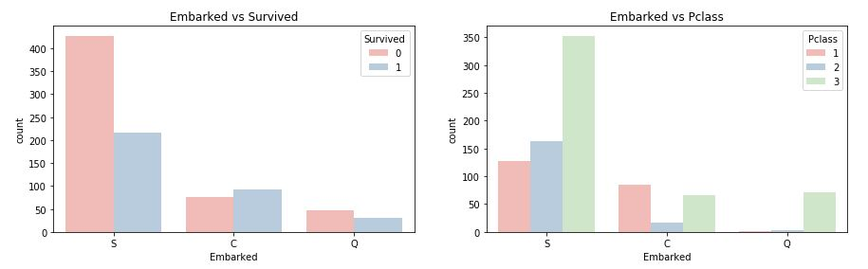
Passengers embarked …

Slide 11
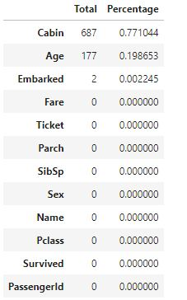
Preprocessing (missing values):

Slide 12
Preprocessing steps:
fill the missing values of embarked column
fill the missing values of Age by calculating mean
use interpolate function to take care of the missing values in fare column and Cabin column
create new column name Title from name column
to fill the missing values of Age by calculating mean using column Title with same values
changing categorical value to numerical value

Slide 13
Models & Parameters used to train
Test size used for the split = 0.2
To display & interpret the results of the model easily, we have used Confusion matrix which will have details like F1, Recall & Precision.
Models used
Logistic Regression
Decision Tree
SVC
Random Forrest

Slide 14
Models used on the train data and its accuracy values:
Logistic Regression – 0.832
Decision Tree – 0.849
SVC – 0.843
Random Forrest – 0.854

Slide 15
Next steps..
The maximum accuracy we obtained so far is 0.854 and we believe this can be improved.
Using the results obtained from 4 models, we are going to use Ensemble Learning model such as Voting Classifier which will combine the decisions from all the model and improve the accuracy.
We observed that hyperparameter tuning (GridSearch CV)has made minimal change in the performance of the model.

Slide 16
Performance metrics after hyperparamter tuning:
LOGISTIC REGRESSION:
Accuracy Score is : 0.8268156424581006
Precision Score is : 0.8028169014084507
Recall Score is: 0.7702702702702703
F1 Score is : 0.7862068965517242
DECISION TREE:
Accuracy Score is : 0.8770949720670391
Precision Score is : 0.8939393939393939
Recall Score is: 0.7972972972972973
F1 Score is : 0.8428571428571429

Slide 17
Continuation:
Random Forest Model
Accuracy Score is : 0.8491620111731844
Precision Score is : 0.8405797101449275
Recall Score is: 0.7837837837837838
F1 Score is : 0.8111888111888113
SUPPORT VECTOR MACHINE
Accuracy Score is : 0.8547486033519553
Precision Score is : 0.8870967741935484
Recall Score is: 0.7432432432432432
F1 Score is : 0.8088235294117647

Slide 18
Conclusion
As part of our implementation we have applied the models on the data and compared the performance after applying hyper parameter tuning and observed that there is only minimal increase/decrease in the performance metrics such as Precision,Recall,F1_score and Accuracy.
Binning can be applied on certain features to improve performance and additional hyperparameter tuning concepts such as RandomSearchCV to further hyper tune the models.

Slide 19
Thank you

